Slide 1
Computer Animation
DESIGN OF ANIMATION SEQUENCE

Slide 2
Computer Animation
Computer Animation is the process used for generating animated images using computer graphics.
Computer-assisted animation and computer-generated animation are two categories of computer animation

Slide 3
Animation Techniques
Animators have invented and used a variety of different animation techniques. Basically there are six animation technique which we would discuss one by one in this section.
Traditional Animation (frame by frame),
Key framing,
Procedural,
Behavioral,
Performance Based (Motion Capture),
Physically Based (Dynamics).

Slide 4
DESIGN OF ANIMATION SEQUNCE
Steps for designing animation sequence
Storyboard Layout
Object Definitions
Key frame specifications
Generation of in-between frames

Slide 5
1.STORYBOARD LAYOUT
A storyboard is a plan, a way of figuring out the story of the film before you put in the enormous amount of work of the animation itself. Basically, it is the story of the movie drawn in pictures, very much like a comic strip.
Depending on the type of animation to be produced, the storyboard could be consist of a set of rough sketches or it could be a list of basis ideas for motion.

Slide 6
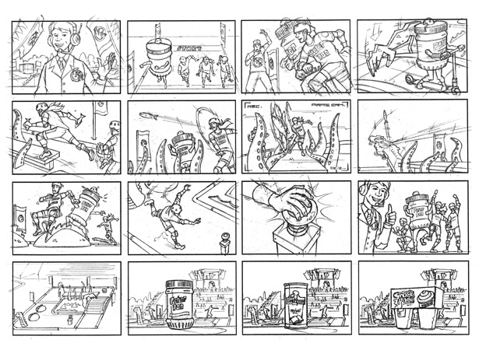
Continue……

Slide 7
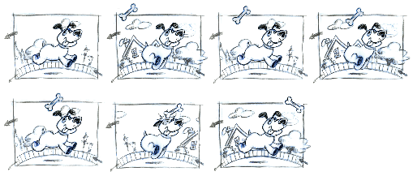
2.OBJECT DEFINITIONS
Each object participating in the action is given object definition, such as terms of basic shapes, such as polygons or splines.

Slide 8
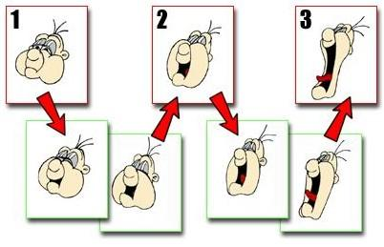
Frame
It is one of the many single photographic images in a motion picture. The individual frames are separated by frame lines. Normally, are needed for one second of film.

Slide 9
3.Key frame specifications
A keyframe is a frame where we define changes in animation. Every frame is a keyframe when we create frame by frame animation. When someone creates a 3D animation on a computer, they usually don’t specify the exact position of any given object on every single frame. They create keyframes.
Keyframes are important frames during which an object changes its size, direction, shape or other properties. The computer then figures out all the in-between frames and saves an extreme amount of time for the animator. The following illustrations depict the frames drawn by user and the frames generated by computer.

Slide 10
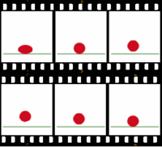
Continue……

Slide 11
4.Generation of in-between frames
It is a process of generating intermediate frames between 2 images to give appearance that the 1st image evolves smoothly into the second image. In-betweens are the drawing between the key frames which help to create the illusion of motion.
Film requires 24 frames per second and graphics terminals are refreshed at a rate of 30 to 60 frames per second.

Slide 12
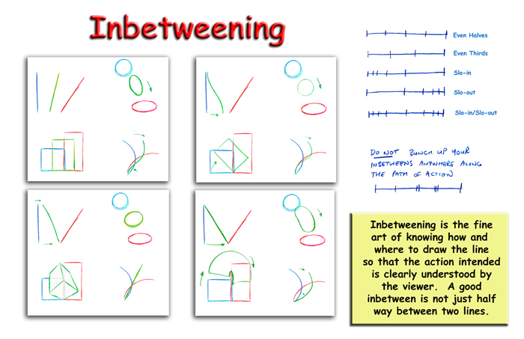
Continue……
In between frames work as intermidiate frames between 2 key frames

